Slide 1
Project 3: Neural Networks
IE 4910
4/20/20
James Sloan

Slide 2
Cats vs Dogs
Using CNNs to make a binary image classification

Slide 3
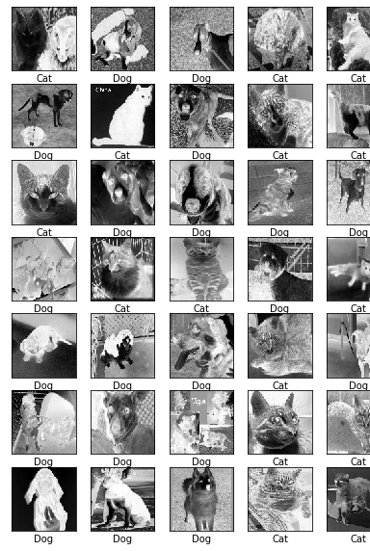
Process the Input Data
Given 1,500 images of cats, and 1,500 images of dogs
50/50 balance is good, no inherent bias
All files are .jpg
6 files are corrupted, leaving 2994
Image size varies widely
Regularized format of data
Converted all images to grayscale to decrease processing speed
Normalized all images to 100x100 pixels
Created shuffled list of (image, label) pairs

Slide 4
Choosing the Layers
Convolutional Layers:
Uses a “window” to scan across parts of the image, then summarizes the data into one number, puts the windows back together, and feeds this into the next layer
By repeating multiple times, this can identify feature patterns in the image
Flatten Layers:
Takes the square input given by an image or a convolutional layer and “flattens” this square data into a vector
This is required before feeding data to a dense layer
Dense Layers:
Fully connected layers to aid in logical decision making
Used at the end of the model to do the final classification task (Cat or Dog)

Slide 5




Building the model
3 Convolutional Layers ((3,3) window size, (2,2) pooling size)
2x 50 node layers for rough pattern detection
1x 100 node layer for more detail capacity
1 Flatten layer
Needed to feed into dense layer
1 Dense layer
Single node, 0 or 1 (Cat or Dog)
Information Flow

Slide 6
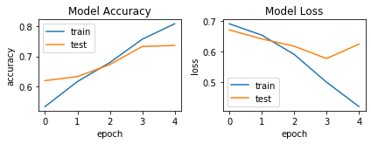
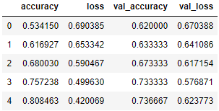
Training the Model
Automatic training stop when validation loss starts increasing using TensorFlow callbacks
Max validation (test) accuracy at epoch 4, min validation loss at epoch 3
Indicated slight overfitting beginning in epoch 4
Final validation accuracy of 0.737

Slide 7
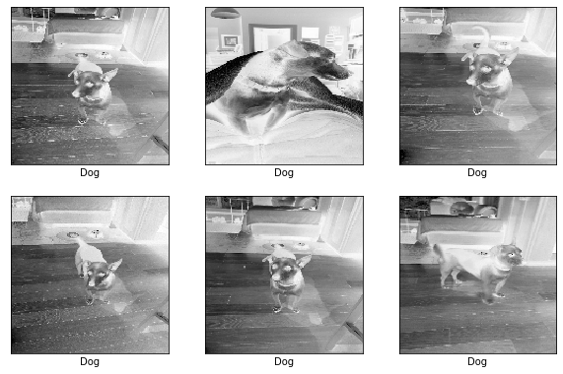
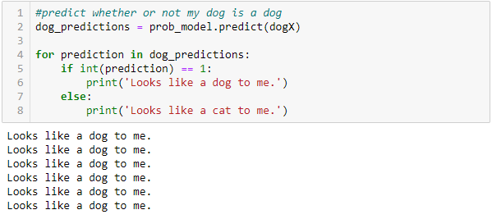
Extra Test With Real World Data
Took some pictures of my dog to feed into my model
It confirmed my suspicions that he is probably a dog

Slide 8
ASL
Using CNNs to classify American Sign Language

Slide 9
Why ASL?
~10,000,000 Americans are hard of hearing and ~1,000,000 are functionally deaf. (source)
ASL is a common method of communication for deaf people and is well recognized in many parts of the world.
With a well trained NN, someone without advanced knowledge of ASL could interpret basic signs as written text or speech through an additional layer of text to speech software.
While most sign language is word based and not letter based, this dataset provides a starting point for looking at letters to see how well a machine could understand sign language.

Slide 10
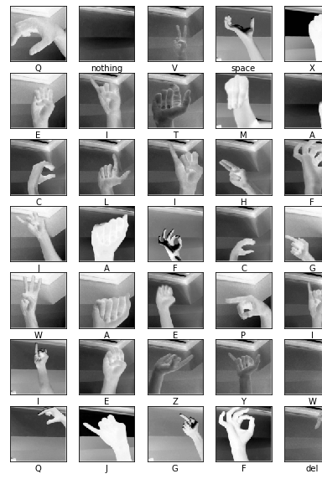
Process the Input Data
Total data file was over 80,000 images, trained on 29,029 images
Equal number of images in each category
29 possible labels for each image: 26 letters, “nothing”, “delete”, and “space”
Data is somewhat limited as it appears to be one guy’s hand
Regularized format of data
Converted all images to grayscale to decrease processing speed
Normalized all images to 100x100 pixels
Created shuffled list of (image, label) pairs

Slide 11
Choosing the Layers
Major difference from the Cats vs. Dogs dataset is the number of classifications
With 29 classifications, more dense layers were needed to aid in logical decision making
Different model constructions were tried: 3xConvolutional, 1xDense / 2xConvolutional, 1XDense / 3xConvolutional, 2xDense / etc. (also played with different numbers of nodes)
Prototyped with ~8,000 images to save time
Found a model that appeared to start learning decently, then fed it all 29k images
More precise parameter analysis could have been done with more time or more processing power

Slide 12
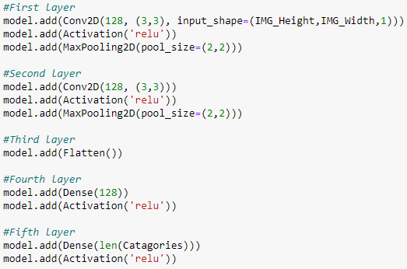
Building the model
2 Convolutional Layers ((3,3) window size, (2,2) pooling size)
128 nodes on all
1 Flatten layer
Needed to feed into dense layers
2 Dense layers
128 nodes on first one
For logical separations to build
29 nodes on last one
For final classification
Information Flow

Slide 13
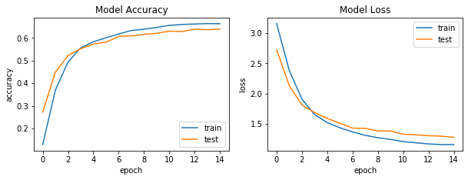
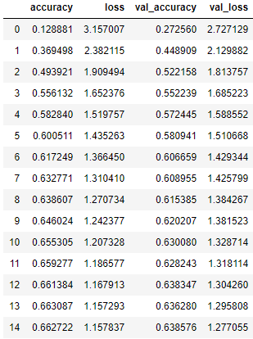
Training the Model
Automatic training stop when validation loss starts increasing using TensorFlow callbacks
Auto stop wasn’t reached, however accuracy started to plateau
Max validation (test) accuracy at epoch 14, min validation loss at epoch 14
Took several hours to run, although slight increases may have continued, it was not worth the computational resources needed to achieve it.
Final validation accuracy of 0.638

Slide 14
Car Crash Severity
Using a NN to predict injuries and deaths in car crashes

Slide 15
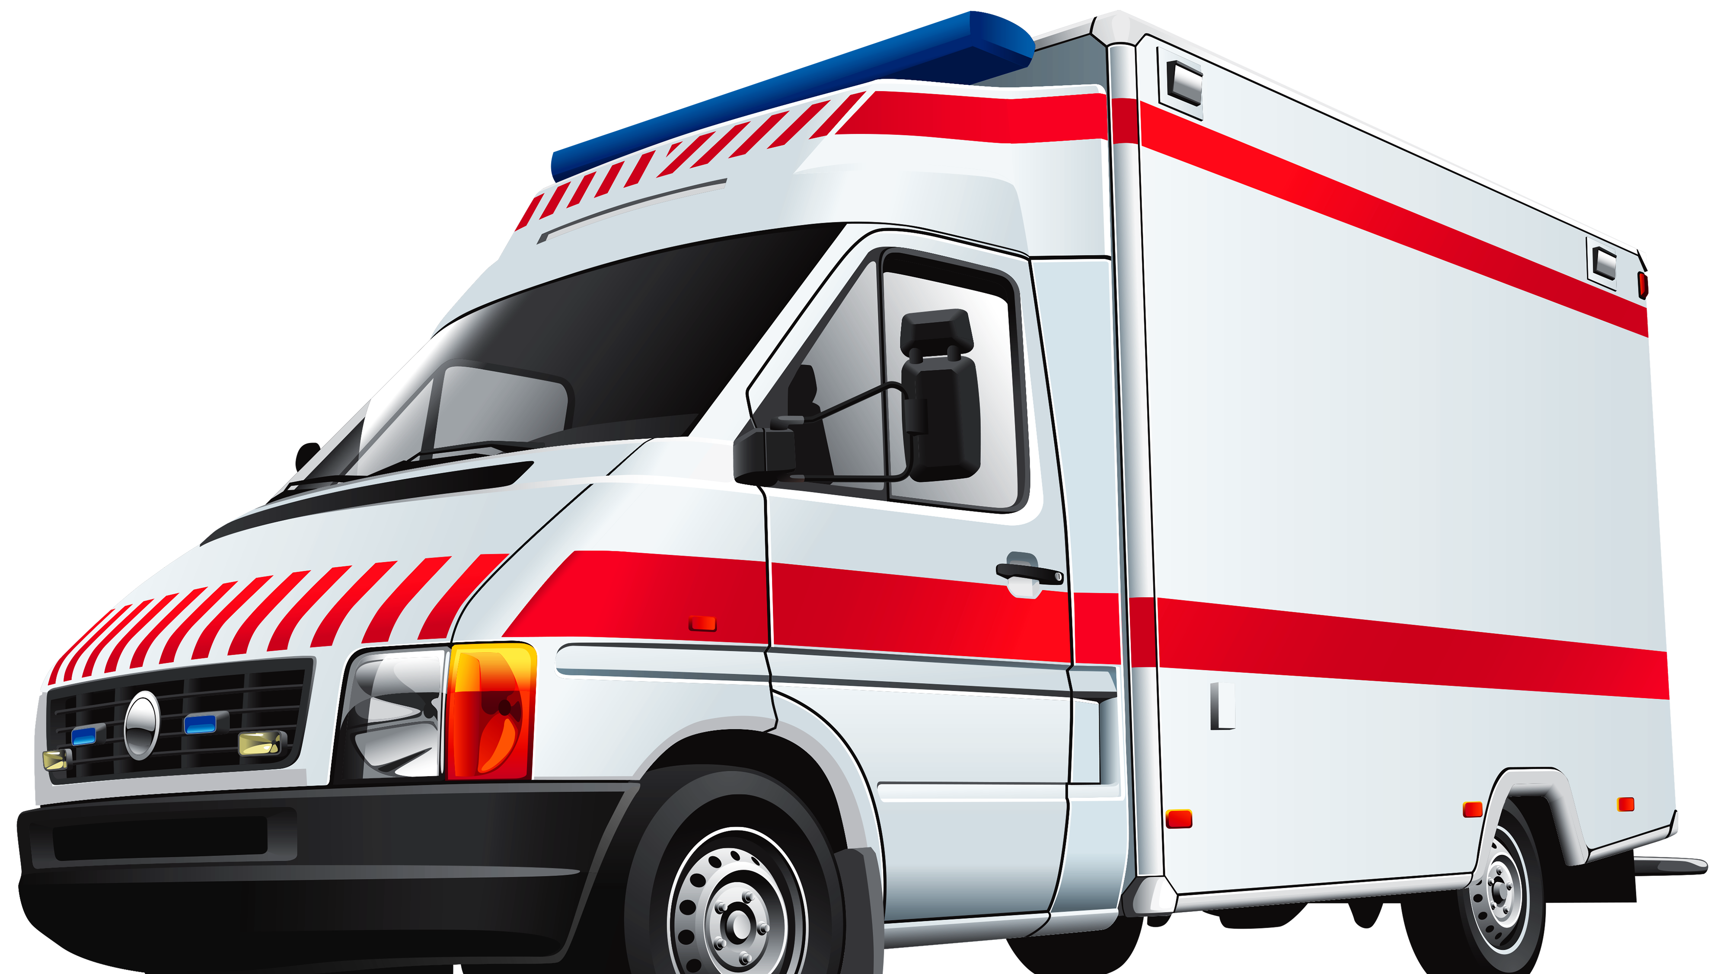
About the data
This data ranks severity on a 1-3 scale (1: Fatal, 2: Serious, 3: Slight)
This is what the NN is trying to predict
Taken from a section of the UK over a 10 year period (2005-2014)
Over 30 variables to consider:
Used: Day of the Week, Road Type, Speed Limit, Junction Control, Light Conditions, Weather Conditions, & Road Surface Conditions
Focused on variables that could be determined quickly after accident location was reported.
By using variables that could be tied to location, a well trained NN could help emergency responders determine priority response locations based on the likelihood of a wreck being “Serious” or “Fatal”.

Slide 16
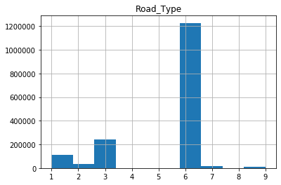
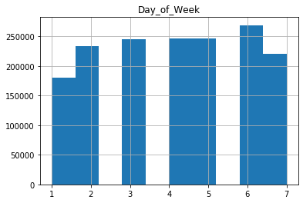
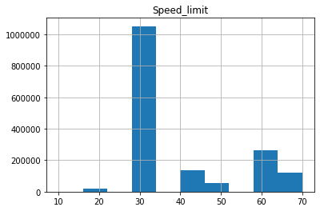
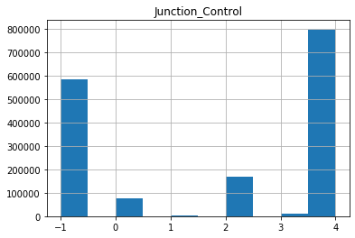
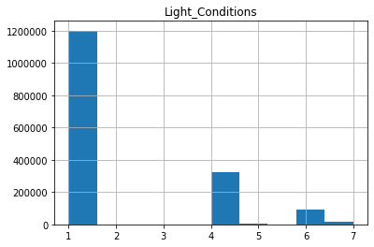
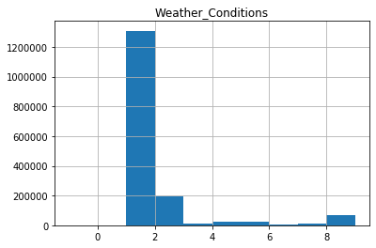
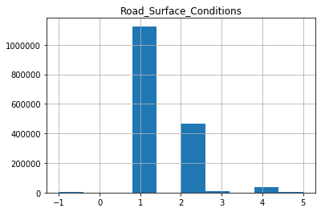
Process the Input Data
Total data file was over 1,600,000 data points
Initially very unbalanced: 21,382 (Fatal), 222,042 (Serious) and 1,297,173 (Slight).
Reduced the dataset to 21,382 of each category to eliminate inherent bias.
Normalize the input arrays
All categorical data was converted to sparse binary information
Speed limit data was scaled 0-1 with 1 being 70mph
Data was shuffled out of the time series order it came in
Road Type Legend most common (6) : One Way Street
Junction Control most common (4): Uncontrolled
Light Conditions most common (1): Daylight
Weather Conditions most common (1): Fine
Road Surface Conditions (1): Dry

Slide 17
Choosing the Layers
Unlike previous datasets, this was not image classification
Significantly less computation needed for each sample
Chose more dense layers with more neurons per layer
Didn’t get great results with any layer structure
Possibly could improve this with more input data or a wider search of layer structures.

Slide 18
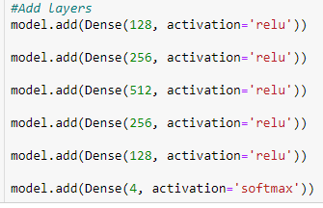
Building the model
100% of layers were dense layers
5 layers in total
Complexity “sandwich”
Creates abstraction, grows in complexity through the 3rd layer
Then simplifies down to output layer
4 output nodes: 0-3
0: No prediction
1: Fatality
2: Serious
3: Slight
Information Flow

Slide 19
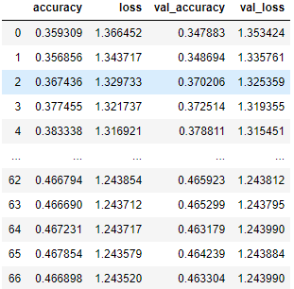
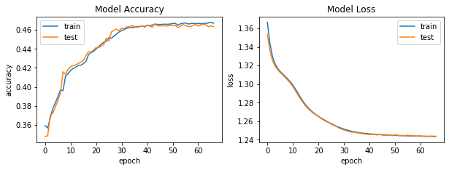
Training the Model
Automatic training stop when validation loss starts increasing using TensorFlow callbacks
Trained for 67 epochs before auto stop kicked in
Model is converging to accuracy of ~0.47, with a loss of ~1.24
The lack of higher accuracy leads me to believe that some inherent randomness in accident outcomes persists. This could potentially be solved with more input data.

